Slide 1

2024 Arizona Youth Survey
2024

Slide 2



About the Arizona Youth Survey
The Arizona Criminal Justice Commission, in partnership with Arizona State University, administers the Arizona Youth Survey every even year. (A.R.S.§ 41-2416)
8th, 10th and 12th grade students participate across Arizona
2024 Participant Total: 42,247
Online survey focuses on the following:
    Substance Use
    Exposure to Violence/Bullying
    Positive/Adverse Childhood Experiences (PACEs)
    Risk and Protective Factors
    Delinquency/Risky Behaviors

Slide 3
Lifetime Youth Substance Use

Slide 4
30-Day 8th Grade Youth Substance Use

Slide 5
30-Day 10th Grade Youth Substance Use

Slide 6
30-Day 12th Grade Youth Substance Use

Slide 7
30-Day Marijuana Use by Grade, 2024

Slide 8
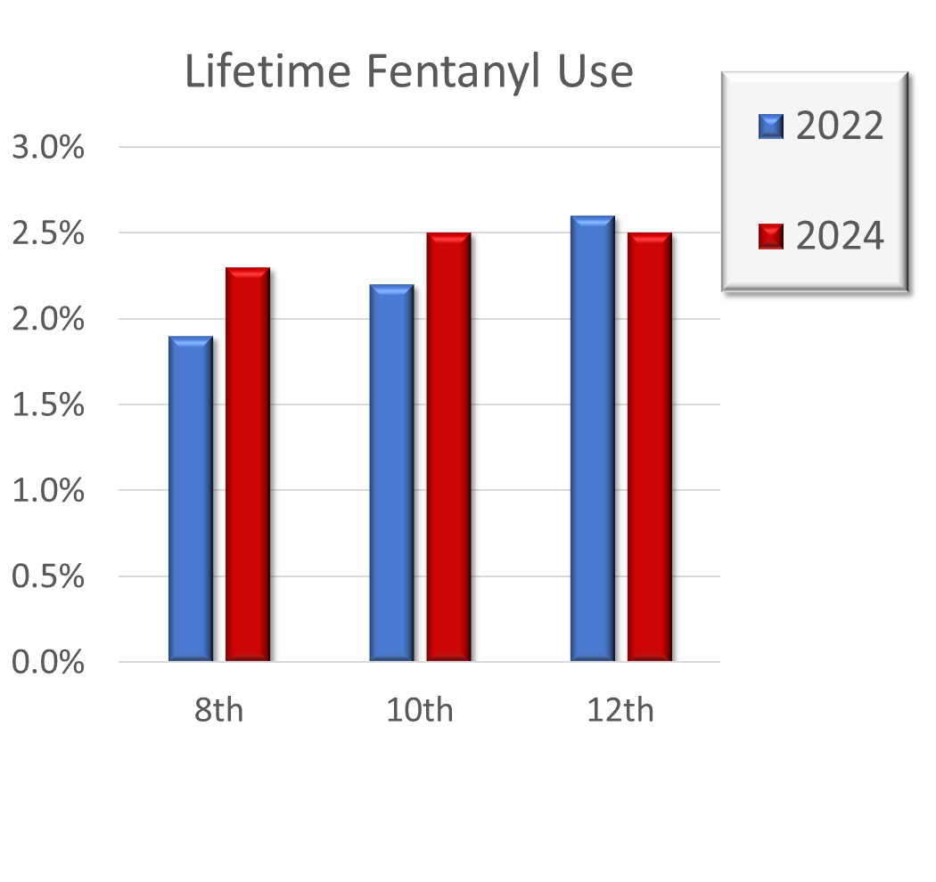
Youth Fentanyl Use

Slide 9



Youth Fentanyl Awareness
Exposed to Messaging on Dangers of Fentanyl
2022 2024
26.0% 54.4%
Aware of Fentanyl
2022 2024
8th: 53.1% 81.3%
10th: 66.4% 91.2%
12th: 75.3% 93.3%
Talked to Parents
2022 2024
17.1% 34.1%

Slide 10
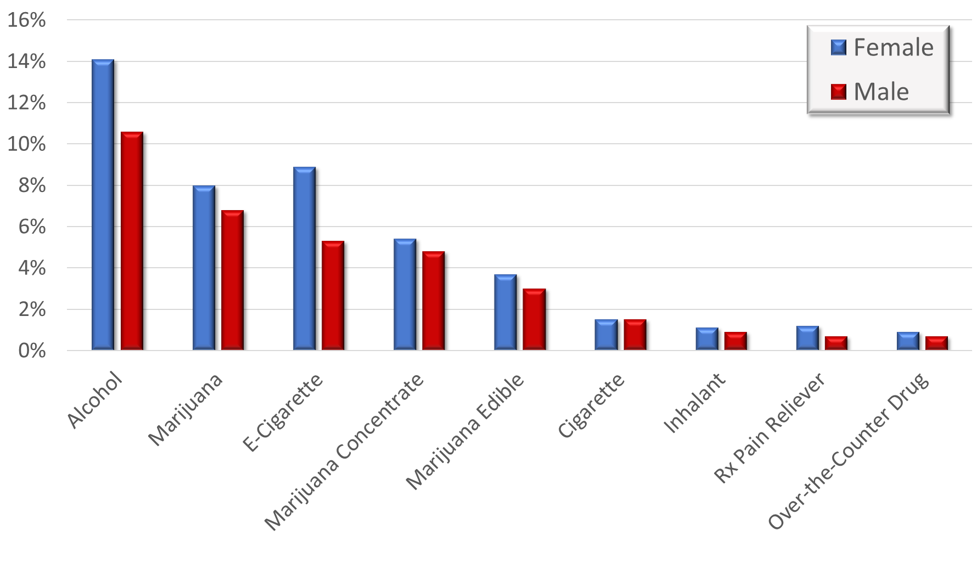
2024 Youth 30-Day Substance Use by Gender

Slide 11
Top 5 Reasons for Substance Use by Gender
Female | Male
1. Have Fun (44.0%) | 1. Have Fun (41.1%)
2. Get High/Feel Good (33.5%) | 2. Get High/Feel Good (30.5%)
3. Deal with Stress from School (31.0%) | 3. Deal with Stress from School (22.4%)
4. Deal with Stress from Parents/Family (28.4%) | 4. Try Something New/Exciting (21.7%)
5. Feeling Sad/Down (25.6%) | 5. Bored/Needed Something to Do (18.4%)

Slide 12
Adverse Childhood Experiences (ACEs)
Parent/Adult Physical Abuse
Parent/Adult Emotional Abuse
Parent/Adult Neglect
Parent Substance Abuse
Parent Incarcerated
Parents Separated/Divorced
Witness to Intimate Partner/Domestic Violence

Slide 13
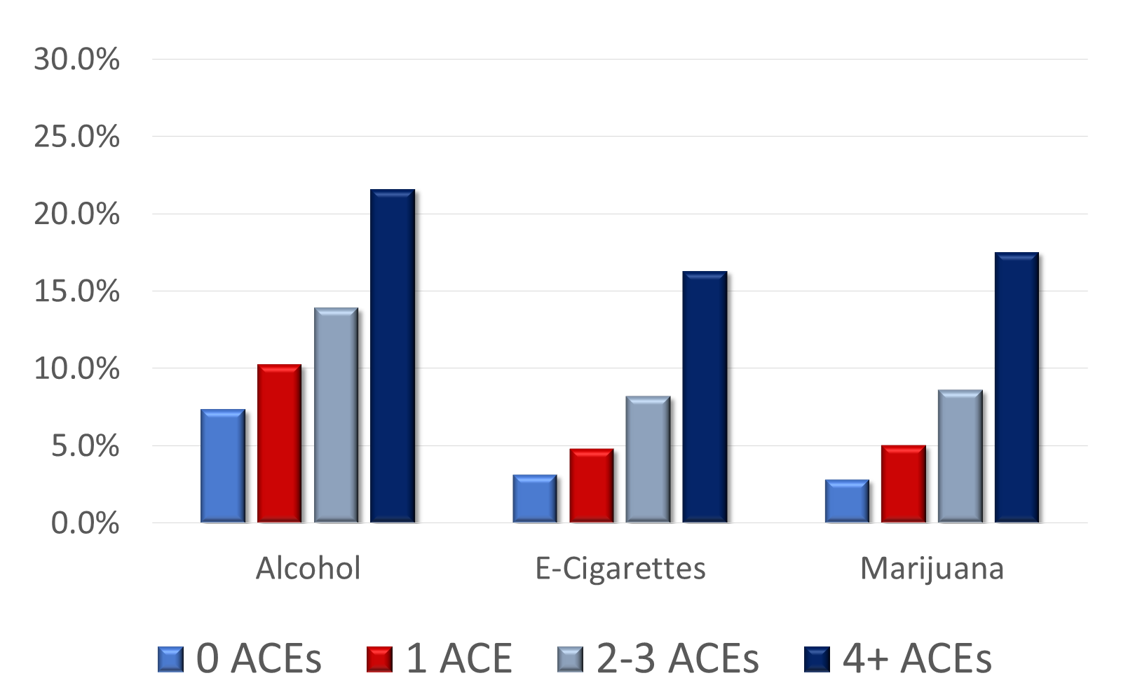
30-Day Substance Use by ACEs Prevalence, 2024

Slide 14
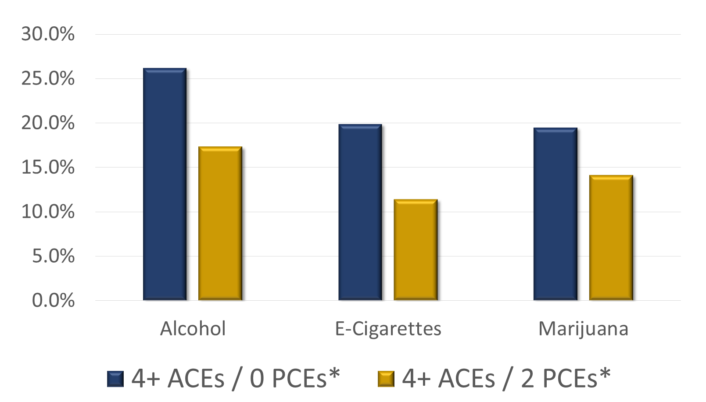
30-Day Substance Use by PACEs Prevalence, 2024
*- Only two PCE’s (Opportunity for School Mentoring and Family Attachment) factored into the calculation.

Slide 15




Youth Risky Behaviors/Delinquency
Texting/Talking while Driving
12th Grade/Past 30 Days
2022 2024
46.8% 54.4%
Cyberbullying (Online/Text)
Past Year
2022 2024
19.7% 21.7%

Slide 16
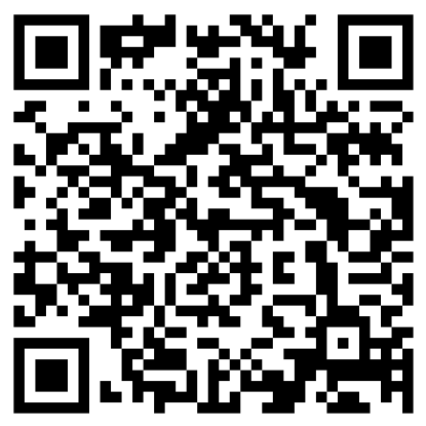
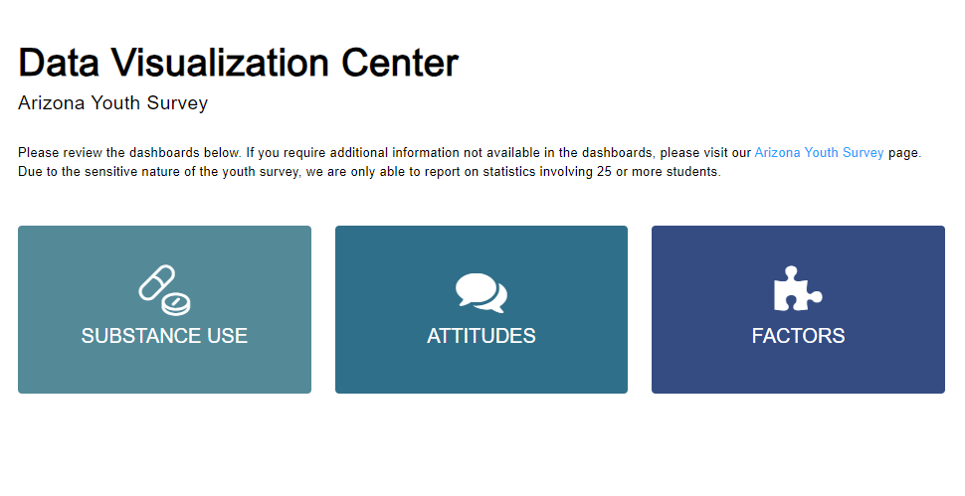
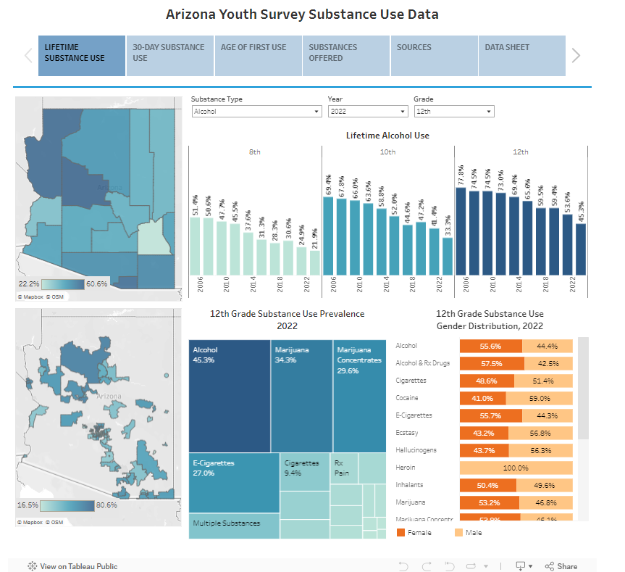
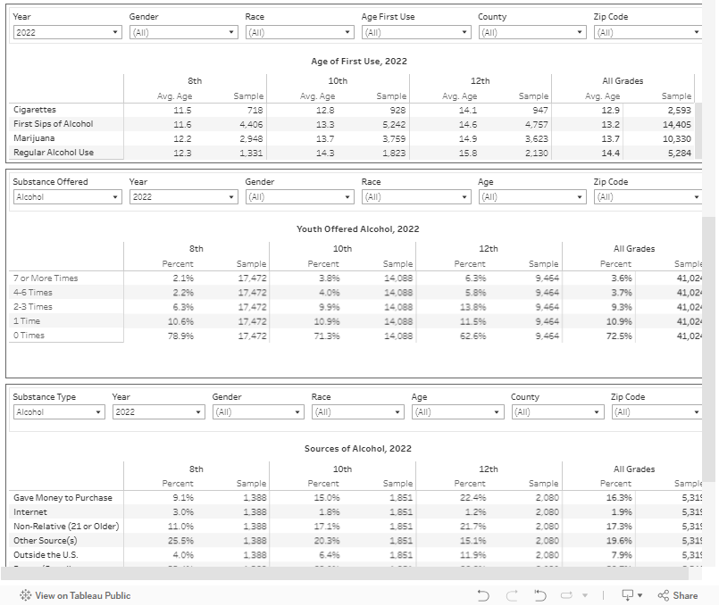
ACJC Data Visualization Center
https://www.azcjc.gov/Data/Arizona-Youth-Survey

Slide 17
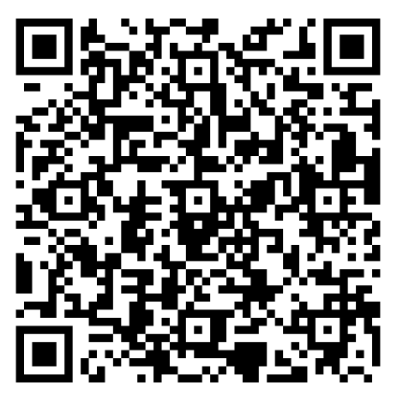
Contact Us
Andrew T. LeFevre, Executive Director
Arizona Criminal Justice Commission
alefevre@azcjc.gov
Allyson J. Horgan, Ph.D.
Statistical Analysis Center Director
Data Integration, Analytics, & Optimization
Arizona Criminal Justice Commission
ahorgan@azcjc.gov
Matt Bileski, M.A.
Program Manager
Data Integration, Analytics, & Optimization
Arizona Criminal Justice Commission
mbileski@azcjc.gov

Slide 18

2024

